Slide 1


SMART INDIA HACKATHON 2024
TITLE PAGE
Problem Statement ID – 1640
Problem Statement Title– Assure Contract
Farming System for Stable Market Access
Theme- Agriculture, FoodTech & Rural
Development
PS Category- Software
Team ID- DYP_SIH_56
Team Name – 4625Farmers

Slide 2
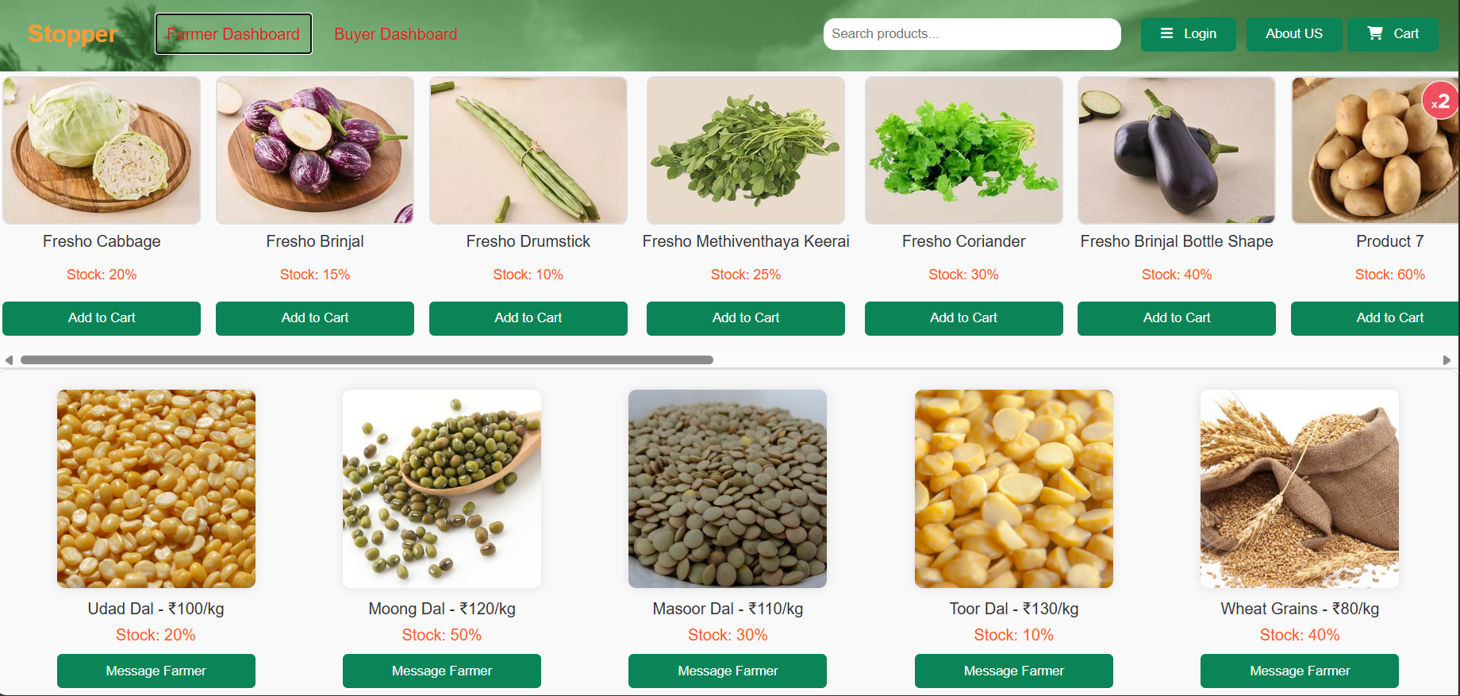
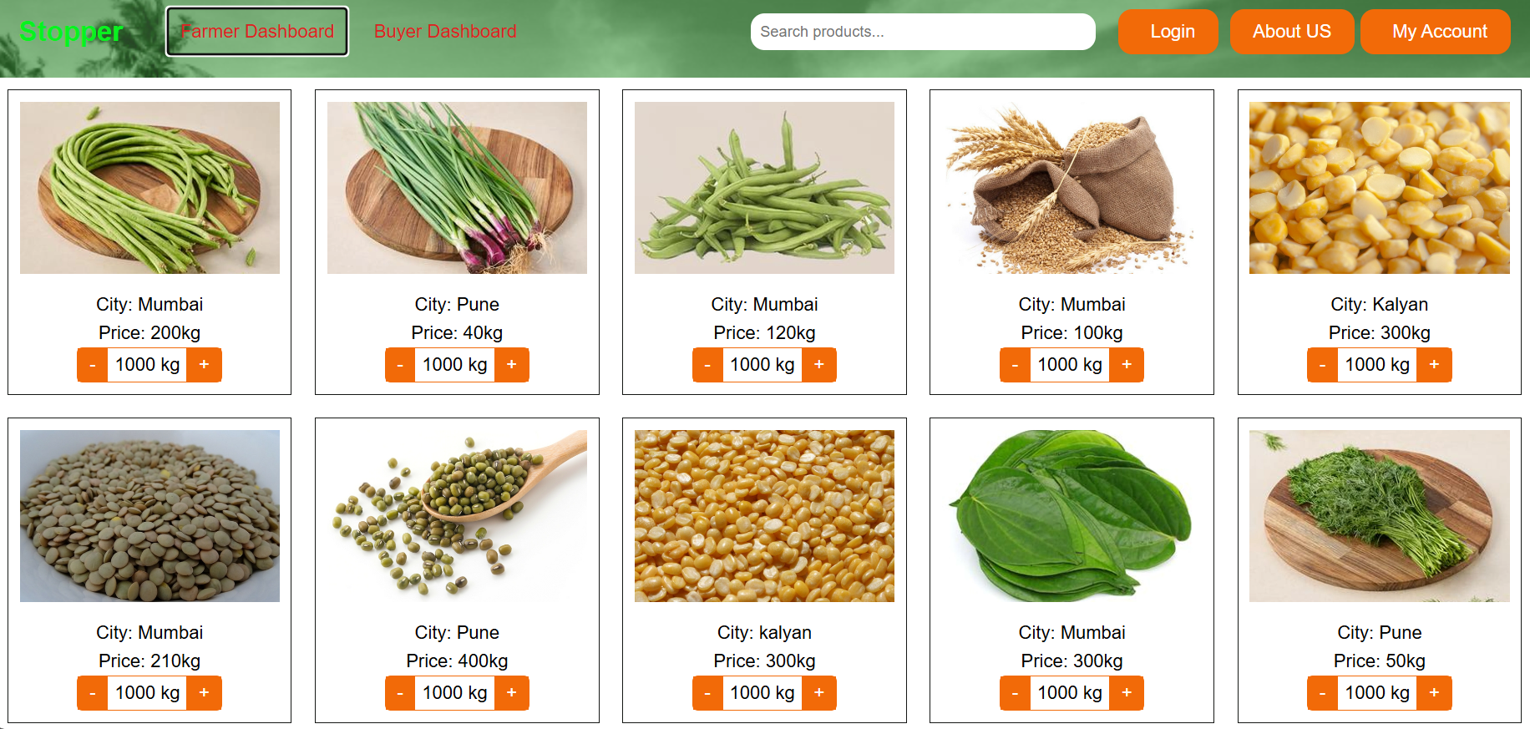
IDEA TITLE
4625Farmers
Problem:
As we know in India, Farmers frequently protest due to unfair pricing and lack of market access Insufficient income. also customer struggles to get fresh, hygienic food daily. Because of this Lots of problems are created suicide, Food crises etc..
Solution:
Stopper is an Platform connects farmers directly with buyers.
Ensures farmers receive full income at a fixed price.
Eliminates the middleman.
Reduces waste and overproduction .
Buyers receive fresh, hygienic food daily.
Guaranteed buyers ,Secured payment.
Key Features/Innovations/uniqueness :
Monthly Data Collection from Buyer:
City-Based Supply:
Continuous Help Support:.
Crisis Alerts Using Weather Prediction:
ML Model for Crop Suggestions:
Efficient demand and supply chain:
Efficient Delivery System:
2

Slide 3
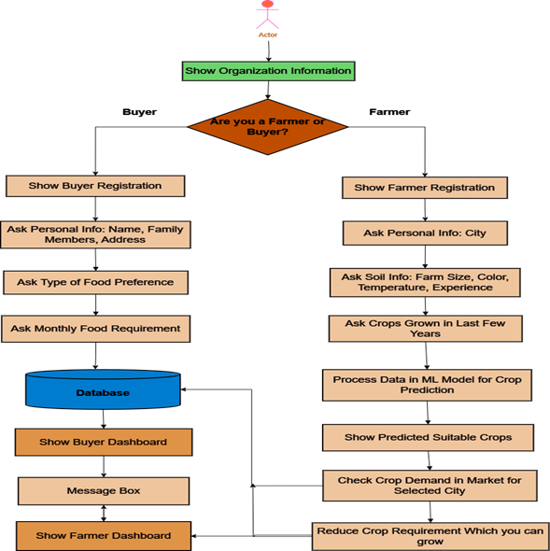








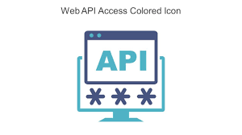

TECHNICAL APPROACH
4625Farmers
Process Flow :-
Technology Stack:-
Product Status
The product is 70% finished, and we are studying the market by looking at research papers and talking to experts. This helps make sure our platform fits current trends and meets real farming needs.

Slide 4
FEASIBILITY AND VIABILITY
4625Farmers
Feasibility :-
Existing Systems: Existing systems are B2B, involve middlemen, and buy food in bulk amount when they have least price and then frozen it. so farmers and buyers does not get benefits from it .
Profitability: By cutting middlemen, farmers earn more income and buyers get fresh food at a lower cost daily .
Demand-Driven Farming: We grow Food based on what peoples actually need, preventing waste and reducing overproduction. we sure that supply matches demand and demand supply chain will be created.
Target Audience Reach: Unlike some current systems that only focus on a 5% People of the market, we target rural areas and middle-class families so it help them to grow with the world . Also Alerts and ML models increase feasibility.
Transportation Cost: We are developing a city-based supply model, which reduces transportation costs, leading to a lower product cost for buyers.
Risks/Problems:- Educating farmers on technology, data and payment security, natural crises affecting crops, data accuracy for ML models, delivering food on time, fluctuating food prices.
Risks/Solutions:
Educating Farmers on Technology: Ensure easy-to-use platform ,proper training so farmers can effectively use technology.
Data Security: Implement strong security measure for payment, analyses farmers & buyers data & send alert on problem.
Natural Crises Alerts: Use AI/ML to predict and alert farmers about natural crises to prepare and respond effectively.
Data Accuracy for ML Models: Maintain and update data regularly, with agricultural experts to improve model accuracy.
Delivery System: Develop a timely and efficient delivery system that also creates job opportunities for People.

Slide 5
IMPACT AND BENEFITS
4625Farmers
Government Impact: The platform helps reduce farmer protests by ensuring fair prices. For buyers, it provides fresh, affordable food, which supports government goals for food security and stable markets.
Potential Impact on the Target Audience:
Farmers: They Gain direct access to buyers, so increasing their income , reducing dependence on middlemen, get suggestion for a crops so they can produce crops effectively and also alerts natural crises so they respond effectively.
Buyers: Access the fresh, hygienic product at stable prices, with more transparency and clarity.
Rural and Middle-Class Communities: the main focused is on rural and Middle-Class families so they are aware about the technology and grow with the word. contributing both environment and India's development. As there are many technology present in a market but they don’t connect the rural areas with them so they does not get benefits we are doing this.
Government Impact: The platform helps reduce farmer protests by ensuring fair prices. For buyers, it provides fresh, affordable food, which supports government goals for food security and stable markets.
Benefits:
Awareness in rural areas: Helps rural and middle-class families to grow with technology and improve their lives.
Increased income for farmers: Direct market access boosts farmers' earnings and reduces financial stress.
Better food for buyers: buyers get fresh, healthy food, so it reducing healthcare issues .
Stop of farmer suicides: Farmers earn a fair income now , reducing financial burdens so now the suicides are stopped.
Environmental benefits: Reduces overproduction and waste, promoting organic farming and sustainability.
Reduced protests: a fair income is for farmers, so the less dissatisfaction are there so no protests against the government.
Boost to GDP: When our needs are met, we can export the food , contributing to national economic growth.

Slide 6
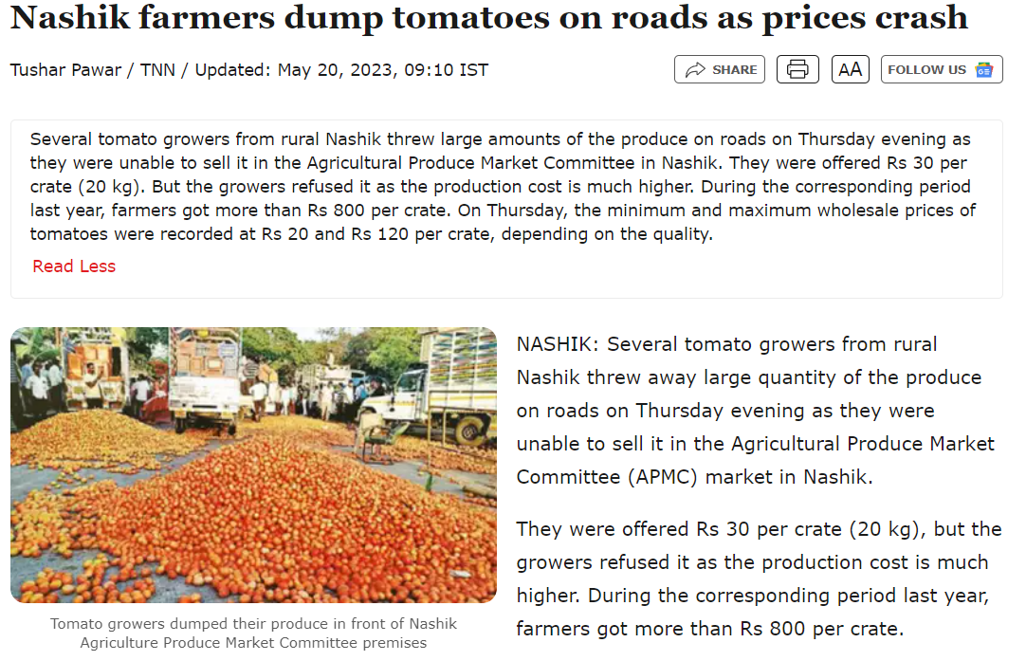
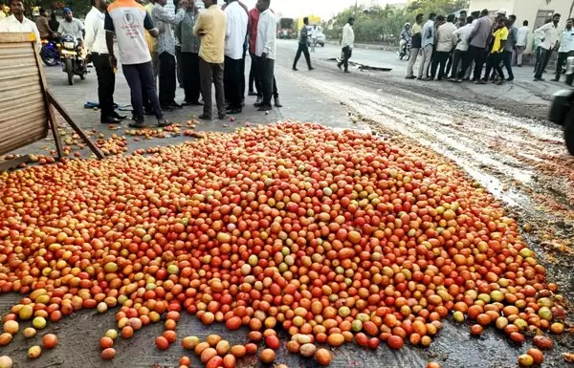
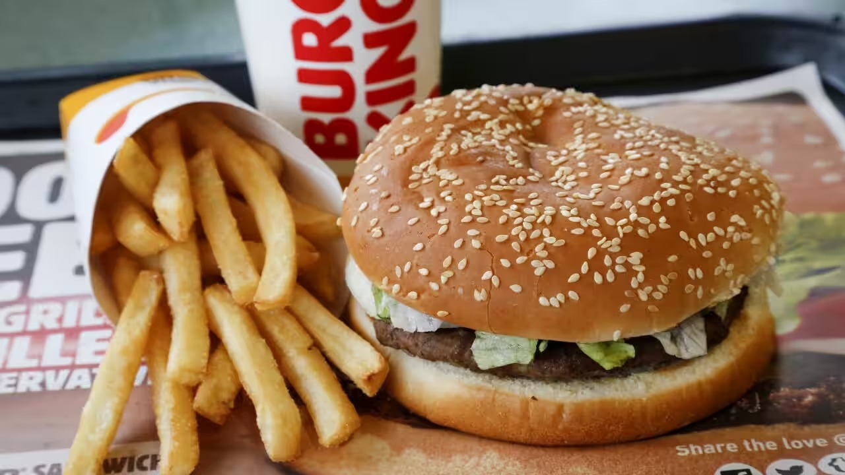
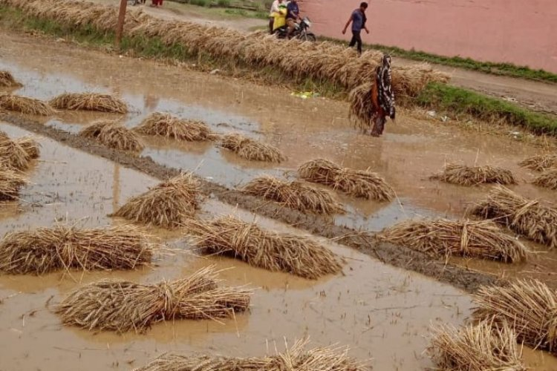
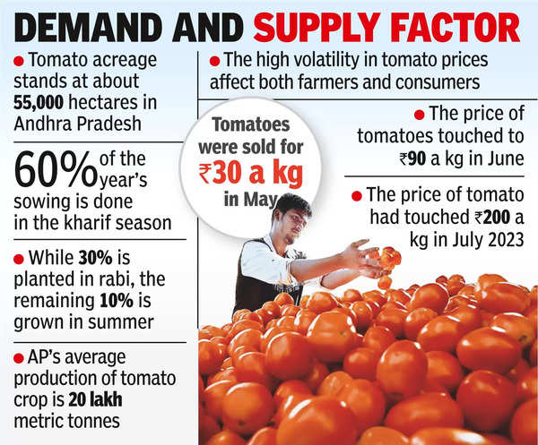
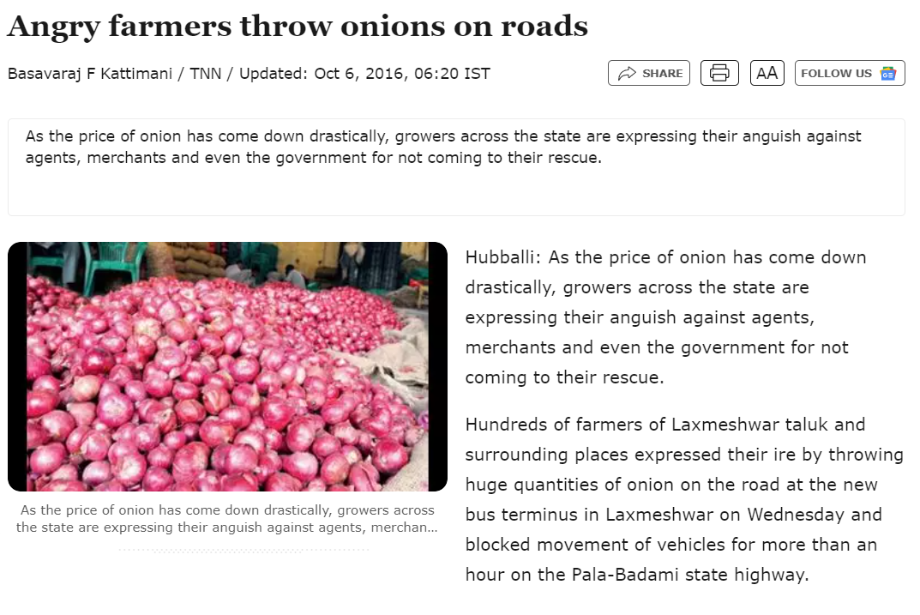
RESEARCH AND REFERENCES
4625Farmers
2May 2023
May 2023
March 2024
Due to farmers having limited market information, access, and no guaranteed buyers, overproduction occurs, leading to waste and sometimes food crises are occurs .
Crisis alert factors work here
Crisis alert factors work here
Crisis alert factors work here

